Slide 1
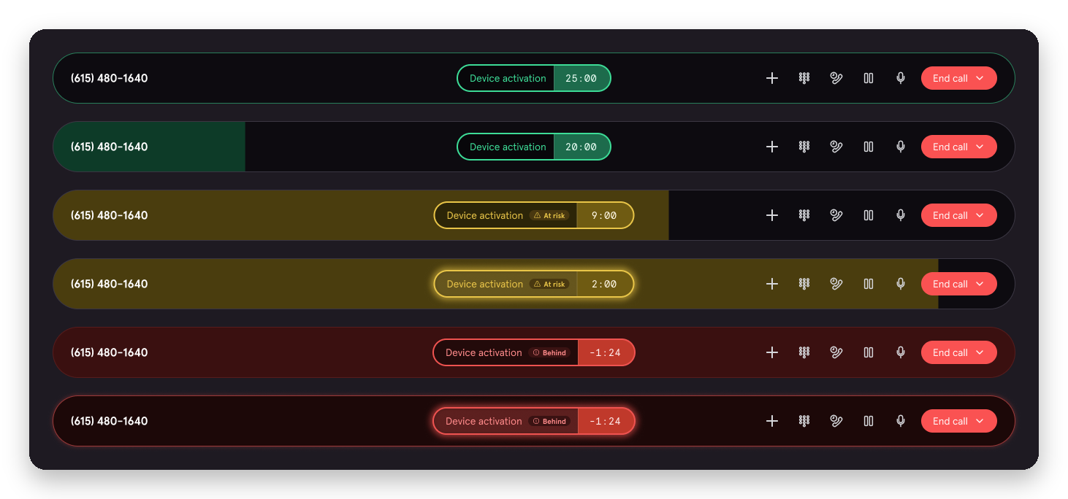
Ship it. Learn.
Then make it beautiful.
The story of Visual Call Pacing
Ricardo De Azua
Notes:
Quick one. This is the story of Visual Call Pacing: how a tiny experiment became one of our bigger levers on call time, and why I'm glad I didn't get my way at the start.

Slide 2
Can a timer make calls shorter?
Notes:
It started as a quick experiment. One question: if experts can see their pace in real time, will they pace themselves? No new scripts, no extra coaching. We tested it with about 14 experts in Orlando in April.

Slide 3


My instinct: design it properly first
Me
Jason & Frank
“Give me a few more weeks.”
“Ship it. See if it works.”
They were right.
Notes:
Confession: my instinct was to take more time and design a cleaner experience. Jason and Frank pushed me to let it go, ship what dev built with a few design recommendations, and see how the test performed before investing more. They were right.

Slide 4
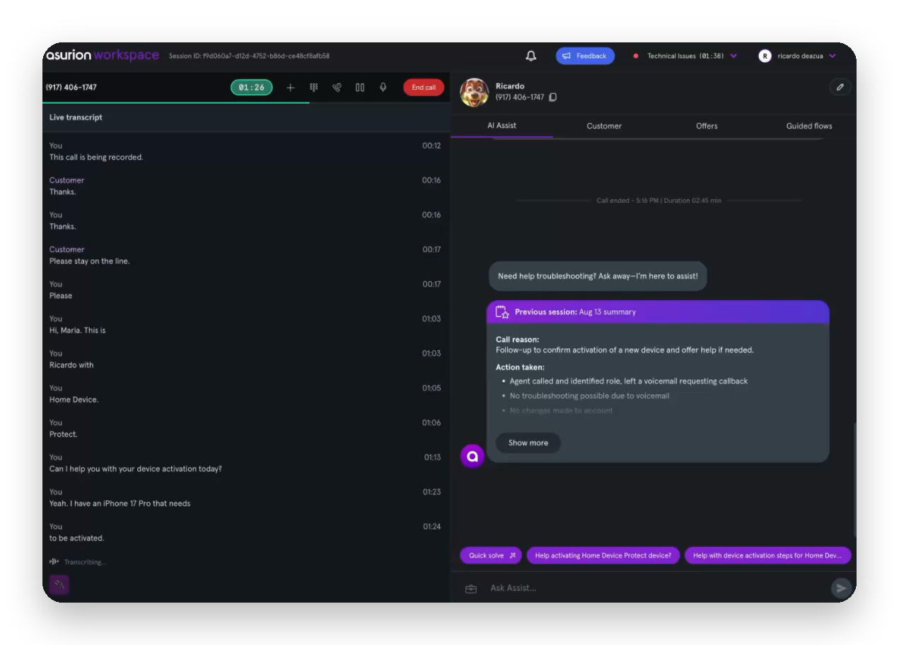
V1: shipped fast, not pretty
Notes:
V1 was dev-led, with a few design recommendations: color states, and keep it inside the existing call bar. A green, amber, red timer pill by call type. Not beautiful, but it was out the door in days.

Slide 5
The early signals were good
48 sec
+2.9 pts
Held
faster calls
resolution rate
sales
Notes:
The pilot answered the question fast. Compared to a 133-expert control group, pilot experts finished calls about 48 seconds faster, resolved more, transferred less, and sales held.

Slide 6
So we went all in.
Apr
Jun
Jul
Pilot
All of Verizon
AT&T
Notes:
That was enough to go all in. Pilot in April, all of Verizon Soluto by June, AT&T in July.

Slide 7

Coaches couldn’t see it from across the room
V1
V1.5
Which one needs help?
Notes:
Then we learned something on the floor. Coaches walk around looking for experts who need help, and from across the room the V1 pill basically disappears. This is V1 and V1.5 blurred to simulate distance. Which one needs help? Exactly.

Slide 8
V1.5: the whole bar does the talking
Same logic. Only the design changed.
Notes:
So we made the call bar the signal. The whole bar fills and shifts green, amber, red, and the timer counts down. Same targets, same logic. Only the design changed, so the A/B test measures design and nothing else.

Slide 9
−21 sec
per call, from design alone
Notes:
Call time is one of our biggest goals for 2026 and 2027. In a clean 50/50 test, V1.5 beat V1 by 21 seconds a call and won every week. At Verizon volume that's roughly 500 handle-hours a week. It rolls out to all of Verizon Soluto on October 29.

Slide 10
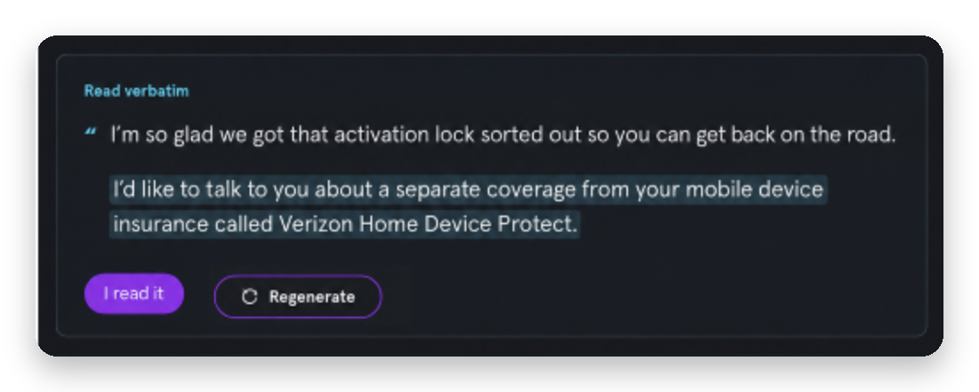
Next: V2 gives selling its own clock
→
Sales 03:40
Notes:
Next is V2, in planning. Today one timer covers the whole call, so a great sales conversation looks like a slow call. In V2 the expert taps 'I read it' on the sales transition and a sales timer takes over. The sales pill here is a concept, not the final design.

Slide 11
Every step: measure, learn, adjust
Apr
Jul
Sep
Oct
Calls got faster
Coaches couldn’t see it
V1.5 won by 21 sec
Some targets are off
→ Scale it
→ Design V1.5
→ Ship it to everyone
→ Tune them, build V2
Notes:
The thread through all of this: we measured at every step and let it change the plan. A control group in the pilot, coach feedback at scale, a clean A/B test for V1.5, and now a call-type deep dive showing where targets need tuning and what V2 should fix.

Slide 12



What I’d tell past me
Ship small
Let data earn the polish
Walk the floor
Notes:
Three things I'd tell past me. Ship the smallest thing that can learn. Let the data earn the polish: V1.5 proved design moves the number. And walk the floor: the best insight came from watching coaches, not a dashboard.

Slide 13
Thanks! Questions?
Notes:
Thanks! Happy to take questions. Updates live in #visual-call-pacing.

